Slide 1
CS 4530: Fundamentals of Software Engineering Module 06: Concurrency Patterns in Typescript
Adeel Bhutta, Mitch Wand
Khoury College of Computer Sciences
© 2023, 2024 Released under the CC BY-SA license

Slide 2
Learning Goals for this Lesson
At the end of this lesson, you should be prepared to:
Explain the difference between JS run-to-completion semantics and interrupt-based semantics.
Given a simple program using async/await, work out the order in which the statements in the program will run.
Write simple programs that create and manage promises using async/await
Write simple programs to mask latency with concurrency by using non-blocking IO and Promise.all in TypeScript.
Notes:
<read slide>

Slide 3
Our goal is to mask latency with concurrency
Consider: a 1Ghz CPU executes an instruction every 1 ns
Almost anything else takes approximately forever
CPU 1
Main Memory
150,000ns (just to read 4KB)
SSD
thread0()
CPU 1 Cache
7ns
100ns
10,000,000ns (just to seek!)
Magnetic HD
Utilize this “wasted” time by doing something else
Processing data
Communicating with remote hosts
Timers that countdown while our app is running
Echoing user input
~100,000,000ns
Earth to moon: ~16,000,000 inches
Remote Computer (Internet in between)
3
Notes:
First principles: why do we need concurrency?
Mostly I/O. We are spoiled today with huge amounts of RAM, but there are still occasions when you need to read or write something to/from disk, or to/from network.
This diagram shows roughly the overhead of different kinds of I/O, in nanoseconds. Cutting-edge hardware architectures and OS designs aim to reduce these delays, but the rough order of magnitudes still stand.
If we are “computing” things (running instructions on the CPU), on a 1Ghz CPU, that’s nice and round, so you get 1 instruction executed per nano-second. You could run 150k instructions in time to read 4KB from SSD, 10m instructions in time to get the read head on your spinning magnetic HD into place to read something, or 100m instructions in time to receive a packet over internet.
So, it is desirable to be able to keep doing things while we are waiting for I/O, and not stop the world. Another way to put this, is that we would like to mask this latency to do such slow operations with concurrency: do something else while these I/O operations are happening.
Summary: Our CPU is faster than everything else that happens in a computer. Most of the time it has to wait for data/values to be read/written before execution next instruction.

Slide 4
We achieve this goal using two techniques: 1. cooperative multiprocessing 2. non-blocking IO
Notes:
cooperative multiprocessing is how we can do many things, not to waste time.
Non-blocking IO stuff is typically done using WebAPIs (by browser).

Slide 5
Most OS's use pre-emptive multiprocessing
OS manages multiprocessing with multiple threads of execution
Processes may be interrupted at unpredictable times
Inter-process communication by shared memory
Data races abound
Really, really hard to get right: need critical sections, semaphores, monitors (all that stuff you learned about in op. sys.)
Notes:
In many programming languages, like Java or C, you can have asynchronous computation with threads.
You might be familiar with this programming model. As it turns out, the “inter-process communication by shared memory” part is extremely hard to get right, and almost impossible to prove correct
This is not how JS or TS does asynchronous computation.

Slide 6
Javascript/Typescript uses cooperative multiprocessing
Typescript maintains a pool of processes, called promises.
A promise always executes until it hits an await or it reaches its end.
This is called "run-to-completion semantics"
A promise can create other promises to be added to the pool.
Promises interact mostly by passing values to one another; data races are minimized.
Notes:
In cooperative multiprocessing, each thread decides when it should yield to let other threads execute. For the purposes of this lecture, we will use the terms 'promise' and 'computation' interchangeably (MAYBE??)

Slide 7
A promise can be in one of exactly 4 states
Executing
there is only one of these; we call it the "current promise" or the "current computation", sometimes the "active promise”
Pending (“waiting”) for some event
Either for some other promise to resolve, or for the runtime to select it for execution.
Fulfilled (“resolved”)
The asynchronous operation has completed, and the Promise's result is a value .
Rejected
The asynchronous operation failed, and the Promise's result is an error.
Notes:
<read slide>. Say something about success/failure?
The official vocabulary uses terms: pending, fulfilled and rejected to describe the state of a promise.

Slide 8
Computations always run until they are completed.
Along the way, it may create promises that can be run anytime after the current computation is completed (i.e. they are in the "ready" state)
It may also create promises that are in the "waiting" state -- waiting for some event or other promises to be completed, at which time they become "ready".
When the current computation is completed (that is, it reaches an await or its end), the operating system (e.g. node.js) chooses some "ready" process to become the next current computation.
Notes:
The idea that a computation runs until it completed is known as “Run to completion” semantic. JS event handler will not get “interrupted” and it will continue its work on the current task. This is true even when you create another async task because that async task will not start executing right away. The control will not switch over to any other task.

Slide 9

Where do promises come from?
Typescript has primitives that create promises.
But you will never do this
Some typescript libraries have API procedures that return promises
this is the usual way you'll get promises.
Most of the time, you'll be building new promises out of the ones that are given to you.
This is what async/await does…
This Photo by Unknown Author is licensed under CC BY-NC
Notes:
<read slide>

Slide 10
async/await creates a pair of promises.
src/async-await/asyncExample.ts
export async function example (n:number) {
console.log("doThisNow", n);
const p1 = somePromise();
const response = await p1
console.log("doThisLater", n);
}
p1: ready
console.log("after await")
waiting
When called, this procedure executes normally until it hits the await, printing out "doThisNow" and binding p1 to the value of somePromise().
When it hits the await, it creates a new promise, containing everything after the await, and marks that promise as waiting for p1.
It puts p1 (now with the yellow promise attached) into the promise pool. The yellow code is blocked.
The call to example(n) returns with the value of p1 (a promise)
The caller of example(n) then continues its execution
Notes:
A more common pattern is for the async function to be used in combination with await. <READ SLIDE> <click when you read "it does three things">
This is an async function; async functions return promises, which this one does (ok!)

Slide 11
A bigger picture
p0: active
example(1);
-----
more code…
p0: active
-----
more code…
p1: ready
console.log("after await")
waiting
"more code" is executed next (“Run to Completion”); meanwhile, p1 is waiting to be selected.
Notes:
Here's a bigger picture, showing the promise that called example(1). Notice that "more code" (the code following the call to example(1)) is the next thing to be executed.
p1 will be selected for execution sometime after p0 is finished. It might be the next thing executed after p0 finishes, or there might be other ready (green) promises in the pool, and the runtime selects one of them instead. But p1 is guaranteed to run eventually.

Slide 12
Simplest example
export async function example(n:number) {
console.log("doThisNow", n);
const p1 = somePromise();
const response = await p1
console.log("doThisLater", n);
}
import { example } from "./asyncExample"
function main () {
console.log("calling example(1)")
example(1)
console.log("main finished\n")
}
main()
$ npx ts-node example1.ts
calling example(1)
doThisNow 1
main finished
doThisLater 1
src/async-await/example1.ts
Notes:
Here, we've bound somePromise(n) to a promise that does nothing but succeeds with n. (You can look at the code in the Examples package, which is linked on the module page for this module.)
<DO AS LIVE DEMO>
Recall: If this was a synchronous program then all statements will run in order.
Demo this by removing “await” from example function!

Slide 13
You can start multiple threads
src/async-await/example2.ts
import { example }
from "./asyncExample";
async function main() {
example(1)
example(2)
example(3)
console.log("main finished\n")
}
main()
$ npx ts-node example2.ts
doThisNow 1
doThisNow 2
doThisNow 3
main finished
doThisLater 1
doThisLater 2
doThisLater 3
Notes:
DO AS LIVE DEMO.
Observe that each call to example puts a promise into the pool and immediately returns.
The 'doThisLaters' only get done after the main promise has finished. Here the promises are executed in the order they were inserted into the pool, but that's not true in general.

Slide 14
Use await to make promises execute sequentially
src/async-await/example3.ts
import { example }
from "./asyncExample";
async function main() {
await example(1)
await example(2)
await example(3)
console.log("main finished\n")
}
main()
$ npx ts-node example3.ts
doThisNow 1
doThisLater 1
doThisNow 2
doThisLater 2
doThisNow 3
doThisLater 3
main finished
Notes:
Here, main() returns a promise. The console.log gets executed, and then the system goes back and executes the promise that main() created. The awaits force these promises to be created sequentially: the promise for example(2) isn't even created until example(1) is finished.

Slide 15
Use Promise.all to synchronize on the completion of several promises
async function forkJoin() {
console.log("forkJoin started")
const promises
= [example(1), example(2), example(3)]
console.log(promises)
await Promise.all(promises)
console.log("forkJoin finished\n")
}
async function main() {
forkJoin()
console.log("main finished\n")
}
$ npx ts-node example4.ts
forkJoin started
doThisNow 1
doThisNow 2
doThisNow 3
[ Promise { <pending> }, Promise { <pending> }, Promise { <pending> } ]
main finished
doThisLater 1
doThisLater 2
doThisLater 3
forkJoin finished
src/async-await/example4.ts
Notes:
Promise.all takes a list of promises, and succeeds when all of the promises in the list have succeeded. This gives us the ability to do a fork/join.
We rely on the runtime or the browser to run these promises concurrently if possible-- we'll see this momentarily.

Slide 16
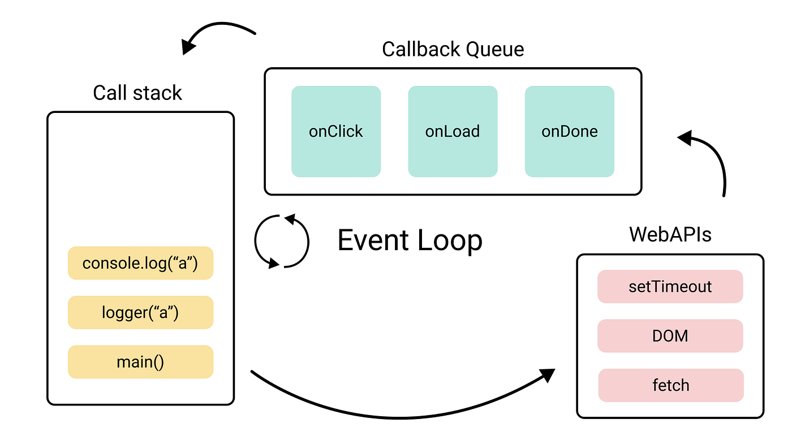
How does JS Engine make this happen?
One Event Loop means that we have single thread of execution
WebAPI are used for asynchronous tasks
Queues are used for “await”-ing tasks
Notes:
<read slide>.
- JS Engine includes a {single} call stack that keeps track of each function that it is being executed
- Asynchronous (heavy) tasks are outsourced to WebAPI. When those are completed, they are placed in a callback queue.
- Event loop picks up “awaiting” {completed} tasks from queue when call stack is empty (i.e., when it is done with everything it was working on – think run to completion) and processes them in the order they were added to queue (i.e., they were completed by WebAPI)

Slide 17
We achieve this goal using two techniques: 1. cooperative multiprocessing 2. non-blocking IO
But where does the non-blocking IO come from?
Notes:
But where does the non-blocking IO come from?

Slide 18
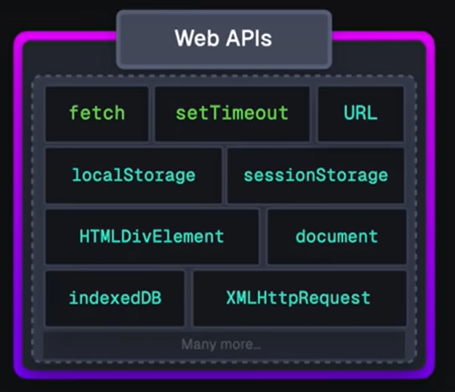
JS/TS has some primitives for starting a non-blocking computation
These are things like http requests, I/O operations, or timers.
We often use WebAPIs for these which allows us to run them on browser asynchronously
Each of these returns a promise that you can await. The promise runs while it is pending, and produces the response from the http request, or the contents of the file, etc.
You will hardly ever call one of these primitives yourself; usually they are wrapped in a convenient procedure, e.g., we write:
axios.get('https://rest-example.covey.town’)
to make an http request, or we write:
fs.readFile(filename)
to read the contents of a file.
Notes:
This is what we said back on the slide with the stork, where we said "Some typescript libraries have API procedures that return promises"

Slide 19
Pattern for starting a concurrent computation
async function makeRequest(requestNumber:number) {
// some code (to be executed now)
const response =
await axios.get('https://rest-example.covey.town')
// more code (to be executed after the .get() returns.
}
The http request is sent immediately.
A promise is created to run the more code after the http call returns (i.e., the code after “awaits” is blocked)
Control returns to the caller of makeRequest.
The promises containing the green and yellow code are left in the promise pool.
Notes:
It is important to note that you can call makeRequest but it will be awaiting a future response. That promise was returned immediately back to the caller (whichever thread called the makeRequest) and the important point to remember is that the caller’s thread continues on while makeRequest is awaiting, just as in our previous examples.

Slide 20
The pattern in action
src/requests/example1.ts
export async function makeRequest(requestNumber:number) {
console.log(`makeRequest is about to start request ${requestNumber}`);
const response = await axios.get('https://rest-example.covey.town');
console.log(`makeRequest resumes request ${requestNumber}`)
console.log(`makeRequest reports that for request '${requestNumber}', server replied: `, response.data);
}
console.log("main thread is about to call makeRequest");
makeRequest(1000);
console.log("main thread continues after makeRequest returns");
console.log("end of main thread")
Axios.get starts the http request in the background, and
Creates a promise to do the code after the await.
3. The call to makeRequest returns.
4. The main thread finishes.
5. The computation resumes the promise
$ npx ts-node example1
main thread is about to call makeRequest
makeRequest is about to start request 1000
main thread continues after makeRequest returns
end of main thread
makeRequest resumes request 1000
makeRequest reports that for request '1000', server replied: This is GET number 200 on the current server
Notes:
Let's see some of our previous examples again, this time with a live http request running as non-blocking IO.
Run to completion semantics are shown in this output. Here the main thread continued its execution after making the request. Event handler will NOT switch to any other task until the main thread is completed (or it yields)

Slide 21
import makeRequest from './makeRequest';
import timeIt from './timeIt'
async function makeThreeSimpleRequests() {
makeRequest(1);
makeRequest(2);
makeRequest(3);
console.log("Three requests made; main thread finishes")
}
timeIt("main thread", makeThreeSimpleRequests)
Running several requests concurrently
src/requests/example2.ts
Requests are made in order
But the response for request 3 arrived at the server before request 1.
$ npx ts-node example2
makeRequest is about to start request 1
makeRequest is about to start request 2
makeRequest is about to start request 3
Three requests made; main thread finishes
Elapsed time for main thread: 41.064 milliseconds
makeRequest reports that for request '3', server replied: This is GET number 223 on the current server
makeRequest reports that for request '1', server replied: This is GET number 224 on the current server
makeRequest reports that for request '2', server replied: This is GET number 225 on the current server
Notes:
The main thread starts the requests and then finishes. Note that the transmission is out-of-order: Request 3 evidently reached the server before Request 1. The responses are handled in the order they are received.

Slide 22
await makes your code more sequential
import makeRequest from './makeRequest';
import timeIt from './timeIt'
async function makeThreeSerialRequests() {
await makeRequest(1);
await makeRequest(2);
await makeRequest(3);
console.log("Three requests made; main thread finishes")
}
timeIt("main thread", makeThreeSerialRequests)
src/requests/example3.ts
$ npx ts-node example3
makeRequest is about to start request 1
makeRequest reports that for request '1', server replied: This is GET number 232 on the current server
makeRequest is about to start request 2
makeRequest reports that for request '2', server replied: This is GET number 233 on the current server
makeRequest is about to start request 3
makeRequest reports that for request '3', server replied: This is GET number 234 on the current server
Three requests made; main thread finishes
Elapsed time for main thread: 800.270 milliseconds
Second request doesn’t start until to first request returns
Notes:
With await, the caller waits for each request to finish before starting the next one.

Slide 23
Promise.all waits for all of the promises in a list to finish
async function makeThreeConcurrentRequests() {
const p1 : Promise<void> = makeRequest(1);
const p2 : Promise<void> = makeRequest(2);
const p3 : Promise<void> = makeRequest(3);
const thePromises = [p1,p2,p3]
await Promise.all(thePromises)
console.log(`main thread reports: thePromises = [${thePromises}]`)
console.log(`main thread finishes`)
}
timeIt("main thread", makeThreeConcurrentRequests)
src/requests/example4.ts
Main thread doesn’t resume until ALL of the promises are satisfied
$ npx ts-node example5
makeRequest is about to start request 1
makeRequest is about to start request 2
makeRequest is about to start request 3
makeRequest reports that for request '2', server replied: This is GET number 259 on the current server
makeRequest reports that for request '1', server replied: This is GET number 260 on the current server
makeRequest reports that for request '3', server replied: This is GET number 261 on the current server
main thread reports: thePromises = [[object Promise],[object Promise],[object Promise]]
main thread finishes
Elapsed time for main thread: 256.518 milliseconds
Notes:
Promise.all allows you to block some process until ALL of the promises are satisfied. Note that the requests are sent in order (1,2,3), but the server report shows that they were not received in order (2,1,3).

Slide 24
Visualizing Promise.all (1)
Sequential version: ~206 msec
Concurrent version: ~80 msec
async function makeThreeSerialRequests(): Promise<void> {
await makeOneGetRequest(1);
await makeOneGetRequest(2);
await makeOneGetRequest(3);
console.log('Heard back from all of the requests')
}
async function makeThreeConcurrentRequests(): Promise<void> {
await Promise.all([
makeOneGetRequest(1),
makeOneGetRequest(2),
makeOneGetRequest(3)
])
console.log('Heard back from all of the requests')
}
“Don’t make another request until you got the last response back”
“Make all of the requests now, then wait for all of the responses”
Notes:
We should leverage concurrency whenever possible.
(Time is average of 100 runs on Prof. Wand’s Lenovo X1)

Slide 25
Visualizing Promise.all (2)
Sequential version: ~206 msec
Concurrent version: ~80 msec
async function makeThreeSerialRequests(): Promise<void> {
await makeOneGetRequest(1);
await makeOneGetRequest(2);
await makeOneGetRequest(3);
console.log('Heard back from all of the requests')
}
async function makeThreeConcurrentRequests(): Promise<void> {
await Promise.all([
makeOneGetRequest(1),
makeOneGetRequest(2),
makeOneGetRequest(3)
])
console.log('Heard back from all of the requests')
}
Time
Time
makeOneGetRequest #1
makeOneGetRequest #2
makeOneGetRequest #3
makeOneGetRequest #1
s
wait for response
r
s
wait for response
r
s
wait for response
r
s
wait for response
r
makeOneGetRequest #2
s
send
s
wait for response
r
receive
makeOneGetRequest #3
r
s
wait for response
r
Notes:
Concurrency lets us mask latency.
Well-written asynchronous code leverages concurrency when possible.
If you have a bunch of things that can be done at the same time, say, making 3 requests to servers, and you don’t care the order in which those requests are made, then do not write code that enforces any ordering. The example on the right will produce output that might have a different order than the one on the left, but if we are OK with that, we can mask how slow that I/O is by doing things concurrently.
(Click through builds to see the sequence of operations. The * stands in for console.log, boxes are not to-scale. Notice how on the concurrent one the results got printed as 3,2,1.
In this simple example the performance difference is a small absolute number (130msec), but another way of saying it is that the code on the left is 2.5x slower!
If you had more concurrent requests to make (say 10 instead of 3), then losing the latency is a bigger loss: 105 vs. 694 msecs: a 7x difference!!

Slide 26
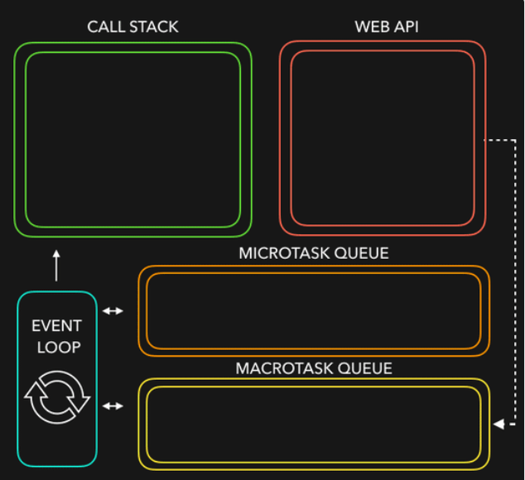
Let’s put it all together
JS/TS has single event loop
We outsource most of the non-blocking IO work (to WebAPIs) for asynchronous work
Upon completion, they are placed in queues (Microtask queue has priority over Macrotask queue)
Event loops picks them up from queue when call stack is empty!
Notes:
Javascript is a single threaded language. This means it has one call stack and one memory heap. It uses WebAPI to work asynchronously.
How do we get asynchronous code with Javascript then?
Well, we can thank the Javascript engine (V8, Spidermonkey, JavaScriptCore, etc...) for that, which has Web API that handle these tasks in the background. The call stack recognizes functions of the Web API and hands them off to be handled by the browser. Once those tasks are finished by the browser, they return and are pushed into a queue (callbacks go in Macrotask queue and promises go into microtask queue)
Then they are picked up by the event loop one by one and added onto the call stack.
Try this http://latentflip.com/loupe

Slide 27
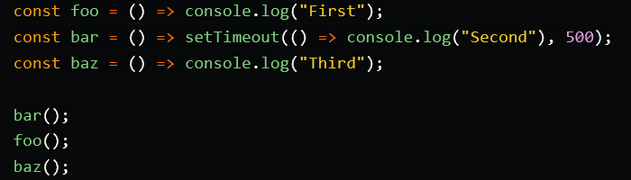
Here is a quick demo for you
Courtesy of https://dev.to/lydiahallie/javascript-visualized-event-loop-3dif
Notes:
Javascript is a single threaded language. This means it has one call stack and one memory heap. It uses WebAPI to work asynchronously.
How do we get asynchronous code with Javascript then?
Well, we can thank the Javascript engine (V8, Spidermonkey, JavaScriptCore, etc...) for that, which has Web API that handle these tasks in the background. The call stack recognizes functions of the Web API and hands them off to be handled by the browser. Once those tasks are finished by the browser, they return and are pushed into a queue (callbacks go in Macrotask queue and promises go into microtask queue)
Then they are picked up by the event loop one by one and added onto the call stack.
Try this http://latentflip.com/loupe

Slide 28
An Example Task Using the Transcript Server
Given an array of StudentIDs:
Request each student’s transcript, and save it to disk so that we have a copy, and calculate its size
Once all of the pages are downloaded and saved, print out the total size of all of the files that were saved

Slide 29
Generating a promise for each student
async function asyncGetStudentData(studentID: number) {
const returnValue =
await axios.get(`https://rest-example.covey.town/transcripts/${studentID}`)
return returnValue
}
async function asyncProcessStudent(studentID: number) : Promise<number> {
// wait to get the student data
const response = await asyncGetStudentData(studentID)
// asynchronously write the file
await fsPromises.writeFile(
dataFileName(studentID),
JSON.stringify(response.data))
// last, extract its size
const stats = await fsPromises.stat(dataFileName(studentID))
const size : number = stats.size
return size
}
Calling await also gives other processes a chance to run.
src/transcripts/simple.ts
Notes:
Each await is associated with a data dependency. DISCUSS: what is the data dependency for the second 'await'?

Slide 30
Running the student processes concurrently
src/transcripts/simple.ts
async function runClientAsync(studentIDs:number[]) {
console.log(`Generating Promises for ${studentIDs}`);
const studentPromises =
studentIDs.map(studentID => asyncProcessStudent(studentID)) ;
console.log('Promises Created!');
console.log('Satisfying Promises Concurrently')
const sizes = await Promise.all(studentPromises);
console.log(sizes)
const totalSize = sum(sizes)
console.log(`Finished calculating size: ${totalSize}`);
console.log('Done');
}
Map-promises pattern: take a list of elements and generate a list of promises, one per element

Slide 31
Output
runClientAsync([411,412,423])
$ npx ts-node simple.ts
Generating Promises for 411,412,423
Promises Created!
Satisfying Promises Concurrently
[ 151, 92, 145 ]
Finished calculating size: 388
Done

Slide 32
But what if there’s an error?
runClientAsync([411,412,87065,423,23044])
$ npx ts-node transcripts/simple.ts
Generating Promises for 411,412,87065,423,23044
Promises Created!
Satisfying Promises Concurrently
<blah blah blah>\node_modules\axios\lib\core\createError.js:16
var error = new Error(message);
^
Error: Request failed with status code 404
Oops!

Slide 33
Need to catch the error
type StudentData = {isOK: boolean, id: number, payload?: any }
/** asynchronously retrieves student data, */
async function asyncGetStudentData(studentID: number): Promise<StudentData> {
try {
const returnValue =
await axios.get(`https://rest-example.covey.town/transcripts/${studentID}`)
return { isOK: true, id: studentID, payload: returnValue }
} catch (e) {
return { isOK: false, id: studentID }
}
}
Catch the error and transmit it in a form the rest of the caller can handle.
src/transcripts/handle-errors.ts

Slide 34
And recover from the error…
async function asyncProcessStudent(studentID: number): Promise<number> {
// wait to get the student data
const response = await asyncGetStudentData(studentID)
if (!(response.isOK)) {
console.error(`bad student ID ${studentID}`)
return 0
} else {
await fsPromises.writeFile(
dataFileName(studentID),
JSON.stringify(response.payload.data))
// last, extract its size
const stats = await fsPromises.stat(dataFileName(studentID))
const size: number = stats.size
return size
}
}
Design decision: if we have a bad student ID, we’ll print out an error message, and count that as 0 towards the total.
src/transcripts/handle-errors.ts

Slide 35
New output
runClientAsync([411,32789,412,423,10202040])
$ npx ts-node transcripts/handle-errors.ts
Generating Promises for 411,32789,412,423,10202040
Promises Created!
Wait for all promises to be satisfied
bad student ID 32789
bad student ID 10202040
[ 151, 0, 92, 145, 0 ]
Finished calculating size: 388
Done

Slide 36
Pattern for testing an async function
import axios from 'axios'
async function echo(str: string) : Promise<string> {
const res =
await axios.get(`https://httpbin.org/get?answer=${str}`)
return res.data.args.answer
}
test('request should return its argument', async () => {
expect.assertions(1)
await expect(echo("33")).resolves.toEqual("33")
})
src/jest/jest-example.test.ts
Notes:
Let's change the subject. How do you test an async function? To test an async function, make the second argument to ‘test’ an async function. This will make ‘expect’ itself an async function, so you will need to ‘await’ its result.
This example is easy, since we are only sending some data to a public web site. If we wanted to do something that might have a global effect (e.g. a transcript database), we'd have to do some mocking. Alas, that is too much for this lecture ☺.
Here, echo is an async function, so it returns a promise, which should eventually return a string (here “33”) to the async function that called it (here, the expect). So here we are saying that we expect echo(33) to return a promise that will eventually resolve to “33”.
Note the await on the next to last line. If you leave that out, the async function in the test will succeed immediately, without waiting for the expect to run. The expect.assertions (in blue) tells Jest that the test should run exactly 1 test, so that will make the test fail if you leave out the await.

Slide 37
General Rules for Writing Asynchronous Code
You can’t return a value from a promise to an ordinary procedure.
You can only send the value to another promise that is awaiting it.
Call async procedures only from other async functions or from the top level.
Break up any long-running computation into async/await segments so other processes will have a chance to run.
Leverage concurrency when possible
Use promise.all if you need to wait for multiple promises to return.
Check for errors with try/catch
Notes:
(Read slide, these points summarize past few slides, adding the note that if you have concurrency, you have concurrency)
Remember that we broke up asyncProcessStudent to give other processes a chance to run; that was an example of the second bullet.

Slide 38
Optional Material

Slide 39
This is not Java!
src/data-races/dataRace.ts
let x : number = 10
async function asyncDouble() {
// start an asynchronous computation and wait for the result
await makeOneGetRequest(1);
x = x * 2 // statement 1
}
async function asyncIncrementTwice() {
// start an asynchronous computation and wait for the result
await makeOneGetRequest(2);
x = x + 1; // statement 2
// nothing can happen between these two statements!!
x = x + 1; // statement 3
}
async function run() {
await Promise.all([asyncDouble(), asyncIncrementTwice()])
console.log(x)
}
In Java, you could get an interrupt between statement 2 and statement 3.
In TS/JS statement 3 is guaranteed to be executed *immediately* after statement 2!
No interrupt is possible.
Notes:
In an interrupt-based model, it is possible that statement 1 runs *BETWEEN*
statement 2 and statement 3, yielding the order of execution
2,1,3 (final value of x is 25).
Luckily, in Typescript run-to-completion semantics, the "critical sections" are much larger; it is much harder to have an accidental data race– you pretty much have to work to create one.

Slide 40
But you can still have a data race
src/data-races/dataRace.ts
let x : number = 10
async function asyncDouble() {
// start an asynchronous computation and wait for the result
await makeOneGetRequest(1);
x = x * 2 // statement 1
}
async function asyncIncrementTwice() {
// start an asynchronous computation and wait for the result
await makeOneGetRequest(2);
x = x + 1; // statement 2
x = x + 1; // statement 3
}
async function run() {
await Promise.all([asyncDouble(), asyncIncrementTwice()])
console.log(x)
}
Notes:
You can still have a data race with async await. Here's the same program we looked at before. Here the printed value of x depends on which of the two promises returns first: if asyncDouble returns first, then the result will be 22 (10*2 + 1 + 1). If asyncIncrementTwice returns first, then the result will be 24 (10+1+1)*2 . But 25 is impossible!

Slide 41
Async/await code is compiled into promise/then code
async function makeThreeSerialRequests(){ 1. console.log('Making first request’); 2. await makeOneGetRequest(); 3. console.log('Making second request’); 4. await makeOneGetRequest(); 5. console.log('Making third request’); 6. await makeOneGetRequest(); 7. console.log('All done!'); } makeThreeSerialRequests();
console.log('Making first request'); makeOneGetRequest().then( () =>{ console.log('Making second request'); return makeOneGetRequest(); }).then(() => { console.log('Making third request'); return makeOneGetRequest(); }).then(()=>{ console.log('All done!'); });
Notes:
Promises

Slide 42
Promises Enforce Ordering Through “Then”
1. console.log('Making requests');
2. axios.get('https://rest-example.covey.town/')
.then((response) =>{
console.log('Heard back from server');
console.log(response.data);
});
3. axios.get('https://www.google.com/')
.then((response) =>{
console.log('Heard back from Google');
});
4. axios.get('https://www.facebook.com/')
.then((response) =>{
console.log('Heard back from Facebook');
});
5. console.log('Requests sent!');
axios.get returns a promise.
p.then mutates that promise so that the then block is run immediately after the original promise returns.
The resulting promise isn’t completed until the then block finishes.
You can chain .then’s, to get things that look like p.then().then().then()
Notes:
Promises enforce the order of operations only through the .then. The code in the ‘then’ won’t run until the promise is resolved.
(build through example, explaining the possible orders of results. Point out that we should never depend on the order of results we hear back form google/facebook/coveytown because it is non-deterministic. You might happen to see 9/10 times one ordering, but there is no guarantee)

Slide 43
Async/Await Programming Activity
We have an activity that extends the transcript example we showed in this module.
Details are linked from the Module 6 web page.
Notes:
For this activity, you will work with an API client that we will provide to interact with our transcript server.
<read slide>

Slide 44
Review
You should now be prepared to:
Explain the difference between JS run-to-completion semantics and interrupt-based semantics.
Given a simple program using async/await, work out the order in which the statements in the program will run.
Write simple programs that create and manage promises using async/await
Write simple programs to mask latency with concurrency by using non-blocking IO and Promise.all in TypeScript.
Notes:
<read slide>

